Slide 1
Midterm Presentation
by Nathan Ho

Slide 2
About Me
Nathan Ho
First place
Senior, BA/MS in CS

Slide 3
Getting Started
Determine the size of the problem.
Identify some of the main challenges.
Determine that there is potential for the task to be possible.

Slide 4
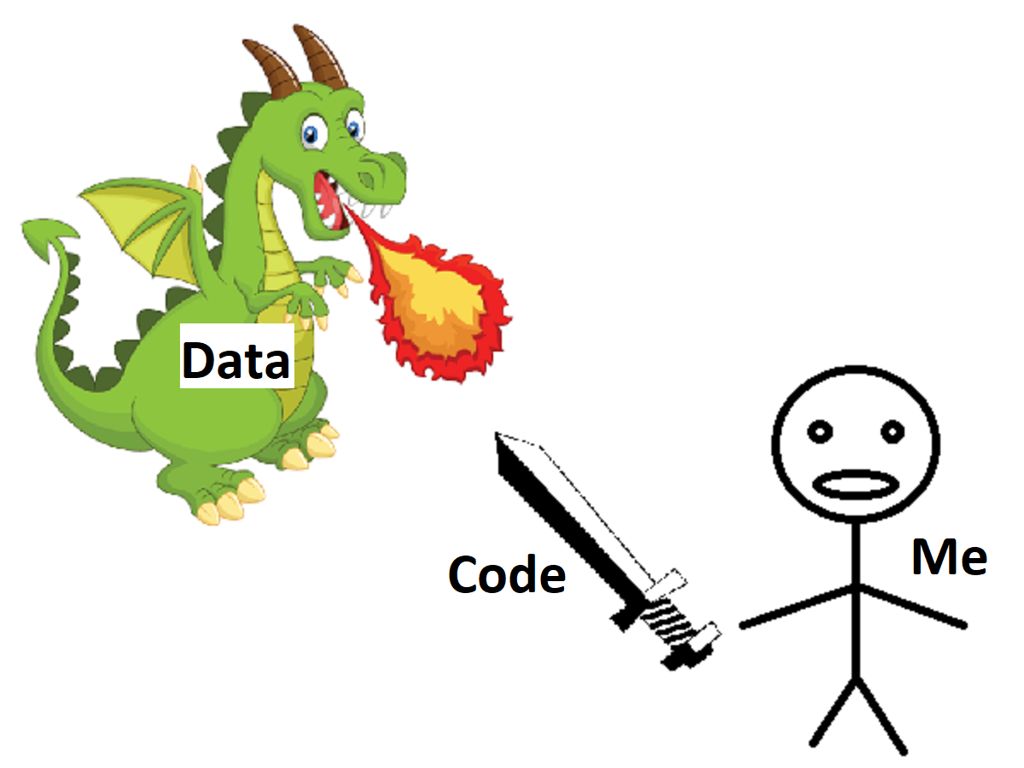
Approaching the Problem
Understand Data through Code.
Notes:
Dragon: https://www.pngkey.com/detail/u2q8w7y3a9i1r5t4_fire-breathing-dragon-wheelchair-costume-childs-imagenes-de/
Sword: https://openclipart.org/detail/222528/toy-sword-black-and-white

Slide 5
Code and Data Are Equivalent
There is a Turing Machine U such that:
U(<M, x>) = M(x)
In order to determine M(x), you can either:
treat M as a program and run M on x, or
treat M as data and run U on an encoding of M and x.

Slide 6
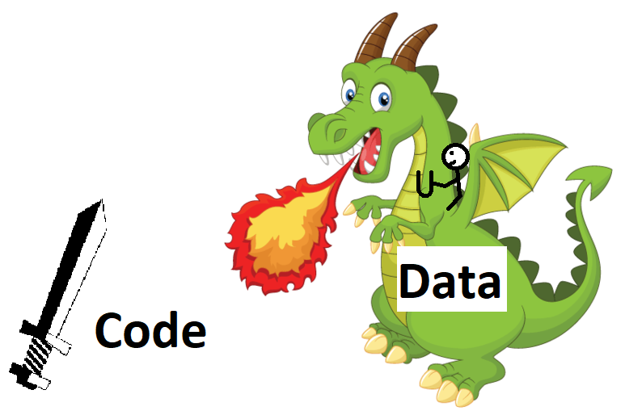
Fighting Dragons With U
Understand Code through Data.
Notes:
Because code and data are equivalent, we switch their places in our approach and now the problem looks a lot easier to take on.
We’re basically trying to understand the code and whether it’s good or not good through the use of our 1.6 million points of data.
I think this view of the problem was good because on this midterm, I had the time of my life fighting dragons with U.

Slide 7
Scarce Resources
Computer time
Programmer time
Scarcity of resources addressed with
General Workflow of Program
General Workflow of Programmer
Notes:
The most notable scarce resources are computer time and programmer time.
I tried to maximize my efficiency with these resources using two frameworks: GWP and GWP.

Slide 8
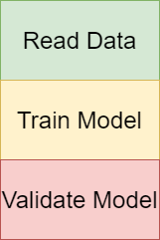
General Workflow of Program
Read data from files.
Train model.
Validate model.
Programmer looks at confusion matrix and validation metrics.
Notes:
All methods fall into this template.
This template is good because the individual parts are capable of expressing all methods imaginable without having to go out of style. It’s structured in a way that naturally leads to reusable code because if you want to make a small change to the method, then it would be easy to make that change and it would be a local change, while the rest of the code gets reused. It uses time efficiently because it only needs to use programmer time at the very end after the computation has finished.

Slide 9
General Workflow of Program
Read data from files.
15 sec to 1 min
Train model.
5 min to several hours
Validate model.
Programmer looks at confusion matrix and validation metrics.
15 sec + programmer attention

Slide 10
Making General Workflow of Program More Efficient
Read data from files.
15 sec - Save intermediate results using pickle library (serialization).
Train model.
At most 1 hour - Train on 1k, 10k, 100k data points.
Validate model.
Programmer looks at confusion matrix and validation metrics.
15 sec + programmer attention - Unavoidable.

Slide 11

Python pickle
Save python objects and load them exactly as they were saved.
Save:
Load:

Slide 12
Making General Workflow of Program More Efficient
Read data from files.
15 sec - Save intermediate results using pickle library (serialization).
Train model.
At most 1 hour - Train on 1k, 10k, 100k data points.
Validate model.
Programmer looks at confusion matrix and validation metrics.
15 sec + programmer attention - Unavoidable.

Slide 13
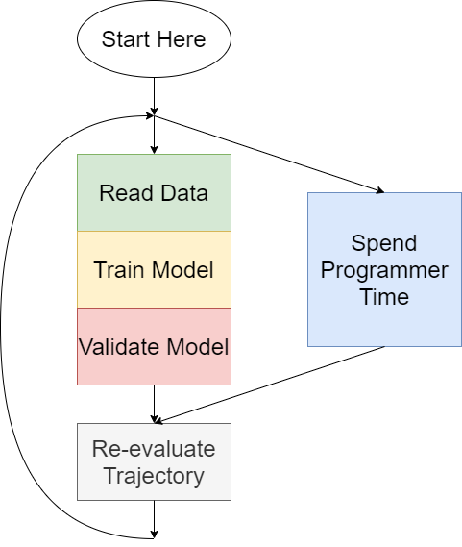
General Workflow of Programmer
Main Idea: Computer is always running a computation while programmer is improving code and methods.
Do General Workflow of Program
Spend Programmer Time efficiently
See General Workflow of Program results and reconsider trajectory. Go to step 1.

Slide 14
Spending Programmer Time
Write the code of next program
Research other methods
Refactor code
Create visualizers
Evaluate workflow
Plan out remainder of current work session
Plan out next work session
Take a break
Notes:
I was sitting in my chair by the window, looking out at the city. Then I wondered what can I do to make a positive impact on the project? Remember that we only want to spend time and energy if there is hope that we can make a positive impact in what we work on. I had already planned out my next experiments and they’d take a few hours each to run. I didn’t see a place to make a direct positive impact on the project, so I instead made an indirect positive impact on the project by making myself happier so I would be more productive when the time came to be. So what did I do?

Slide 15
Spending Programmer Time
Listen to Taylor Swift music.
Notes:
Listen to taylor swift music.
Her music just uplifts my mood so much and made me feel so capable of taking on the challenge of the midterm.
I might be biased… I can’t actually work and listen to music at the same time without losing focus on the work, but her music is just so good.
And I just wanna tell you
It takes everything in me not to listen to her music.
I hope you know that
every time I don’t, I almost do.
I almost do.

Slide 16

Standard Edition
8. Tell Me Why
Platinum Edition
14. Tell Me Why

Slide 17
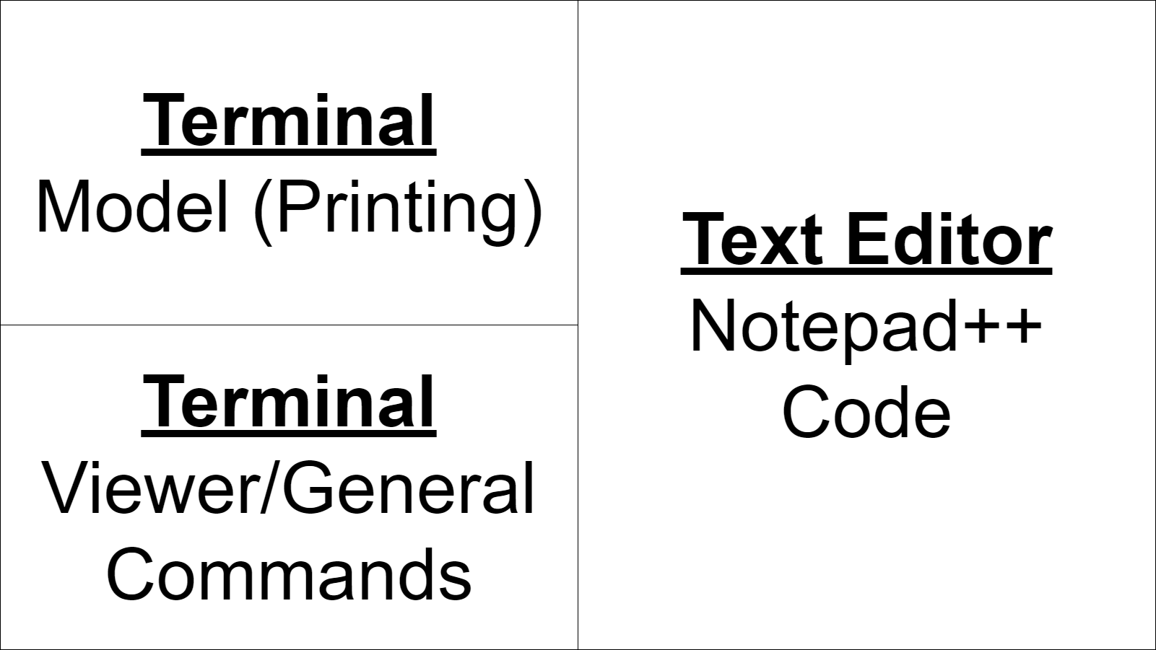
Computer Screen

Slide 18
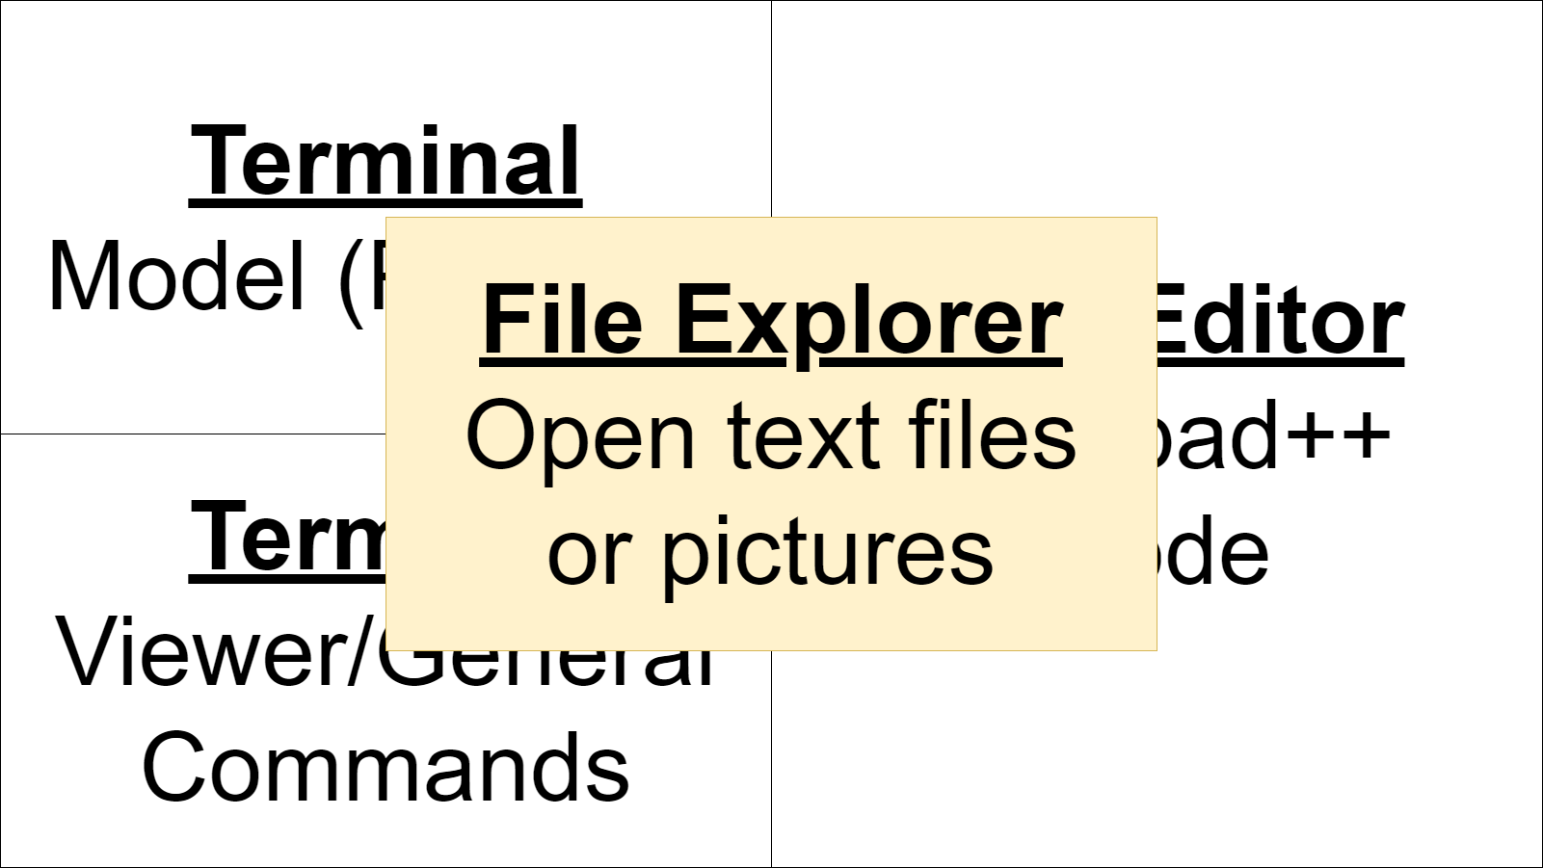
Computer Screen

Slide 19
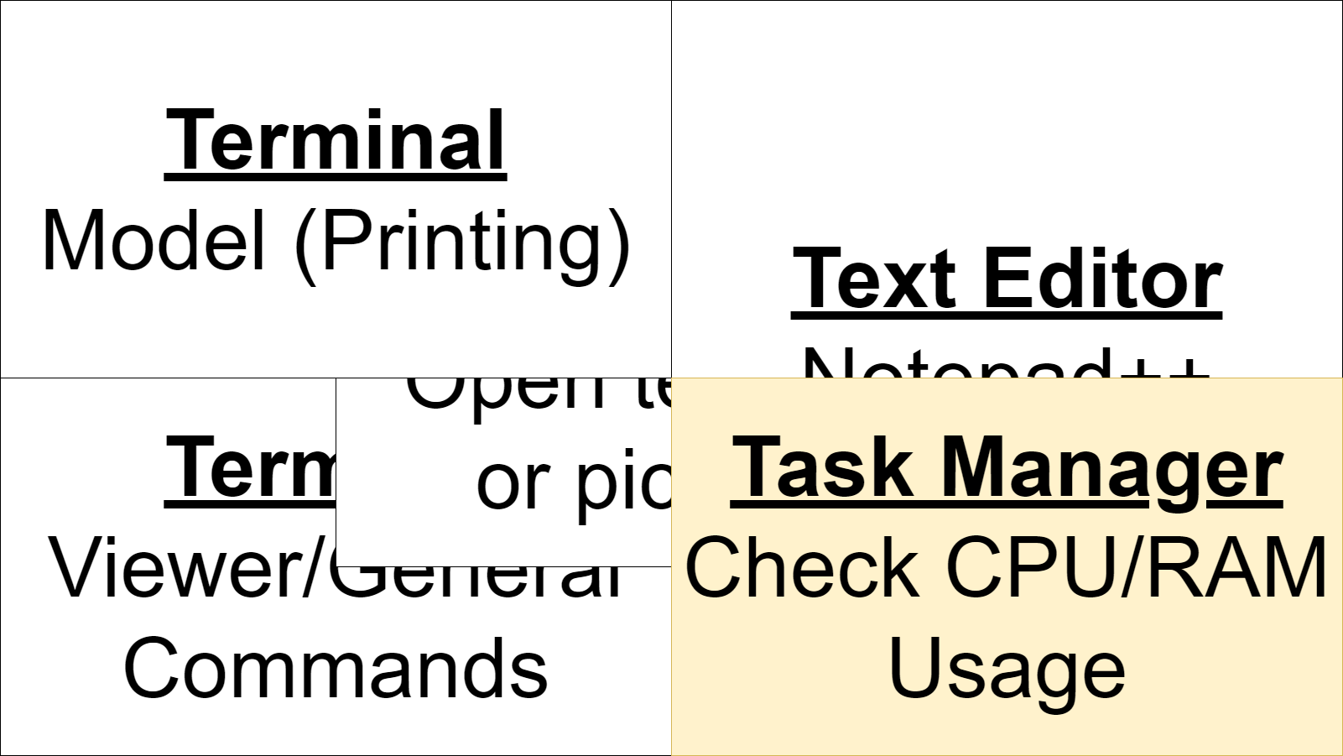
Computer Screen

Slide 20
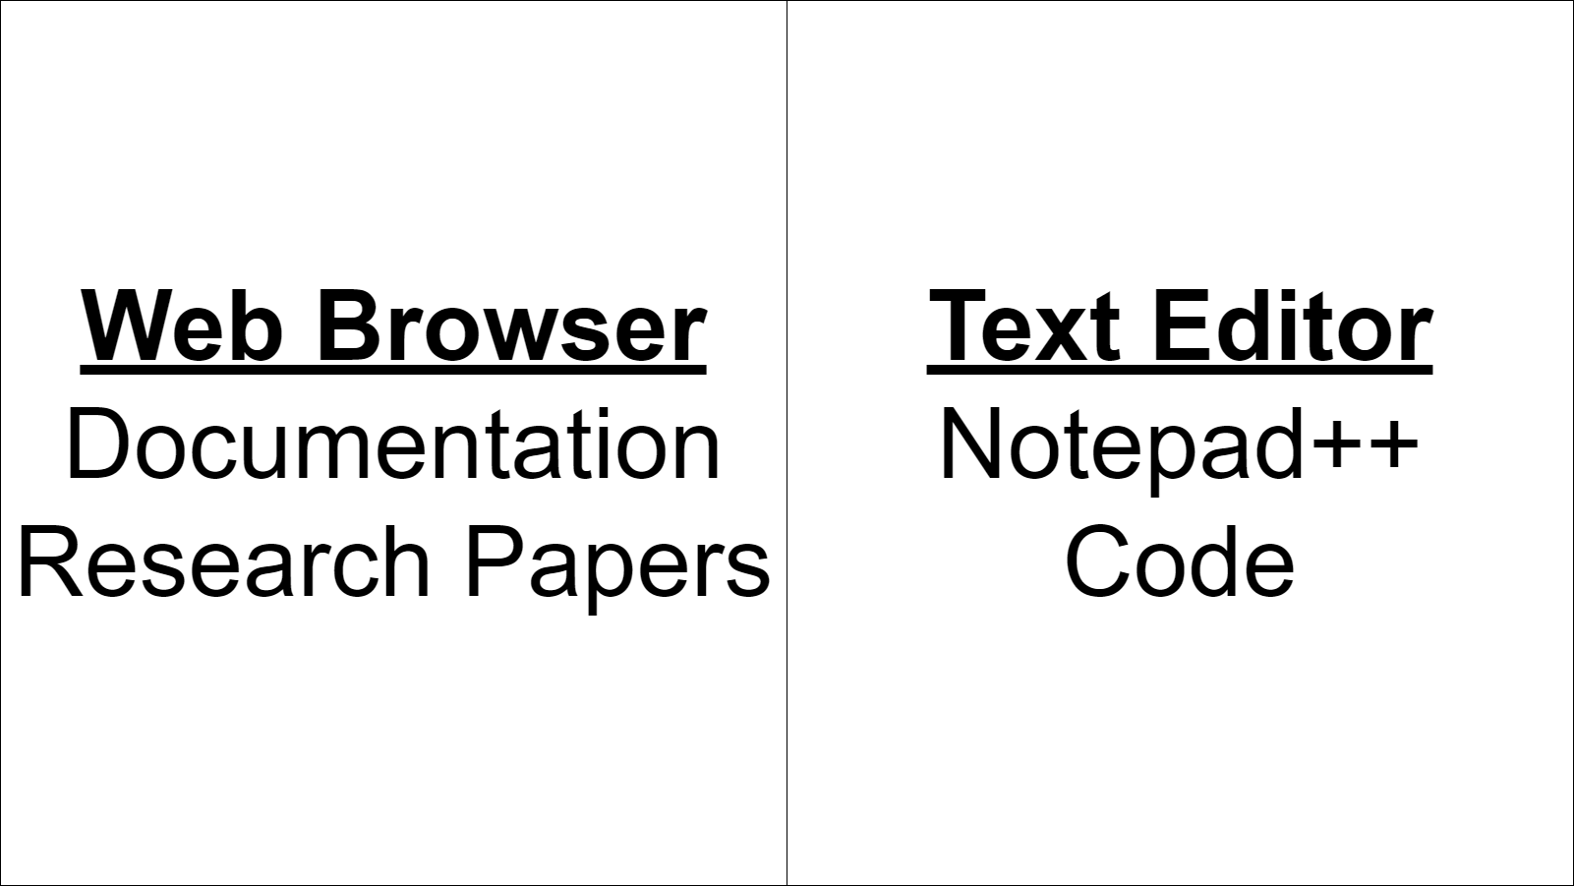
Computer Screen

Slide 21
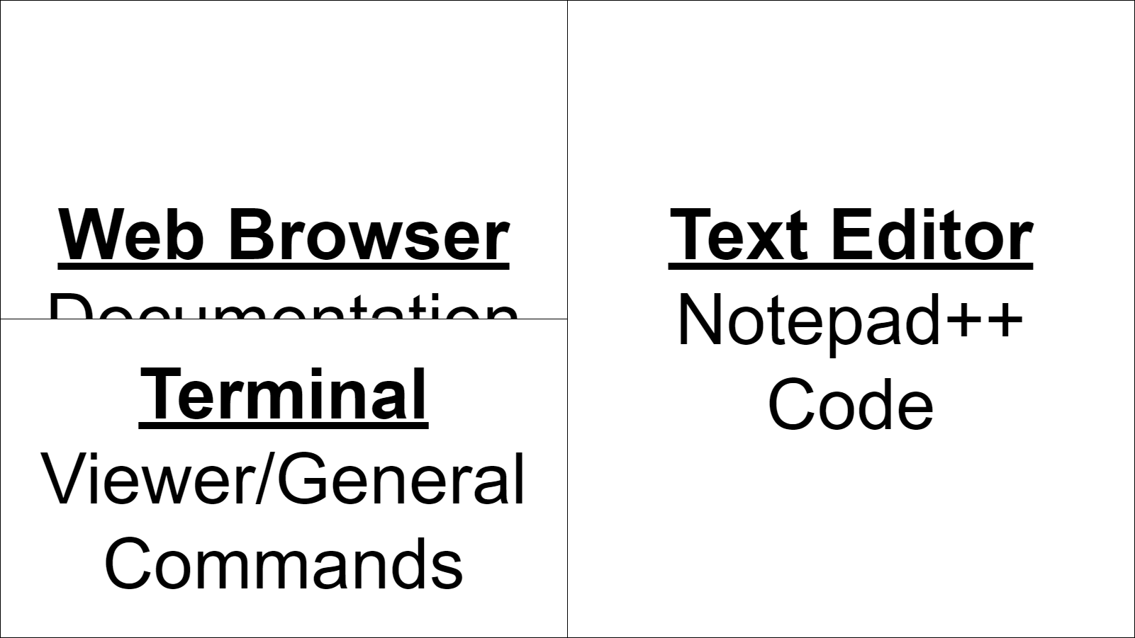
Computer Screen

Slide 22
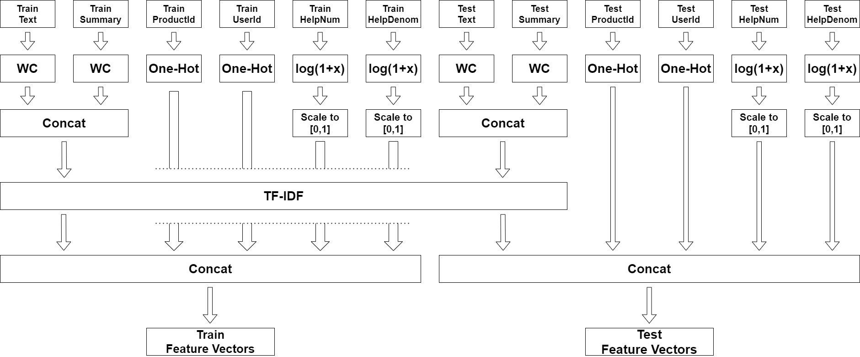
Feature Extraction

Slide 23
Models
sklearn LogisticRegression (slow on full dataset)
sklearn SGDClassifier log loss (didn’t output probability distributions)
PyTorch Multiclass Logistic Regression (difficult to analyze, slow, limit reached)
NumPy Multiclass Logistic Regression (final model)
Multiclass logistic regression generalizes logistic regression to K ≥ 2 classes.

Slide 24
Converting Probability Distribution To Final Prediction
Multiclass logistic regression outputs a probability distribution (soft classifier).
Kaggle requires a single number as the final prediction (hard classification).
The naive method to convert from soft classification to hard classification is to predict the class that has the highest outputted probability mass.

Slide 25
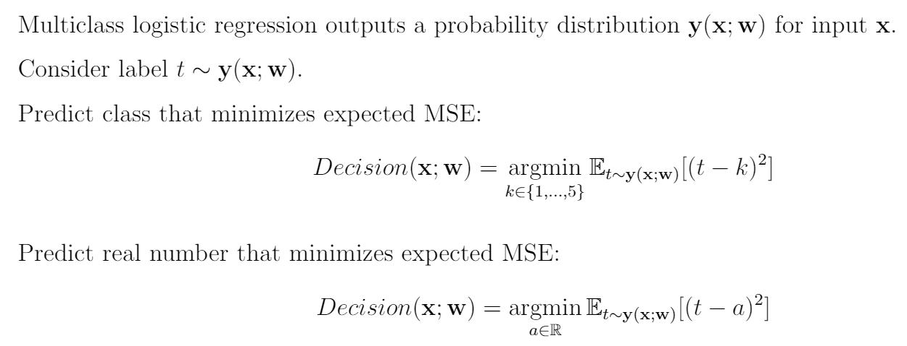
Converting Probability Distribution To Final Prediction

Slide 26
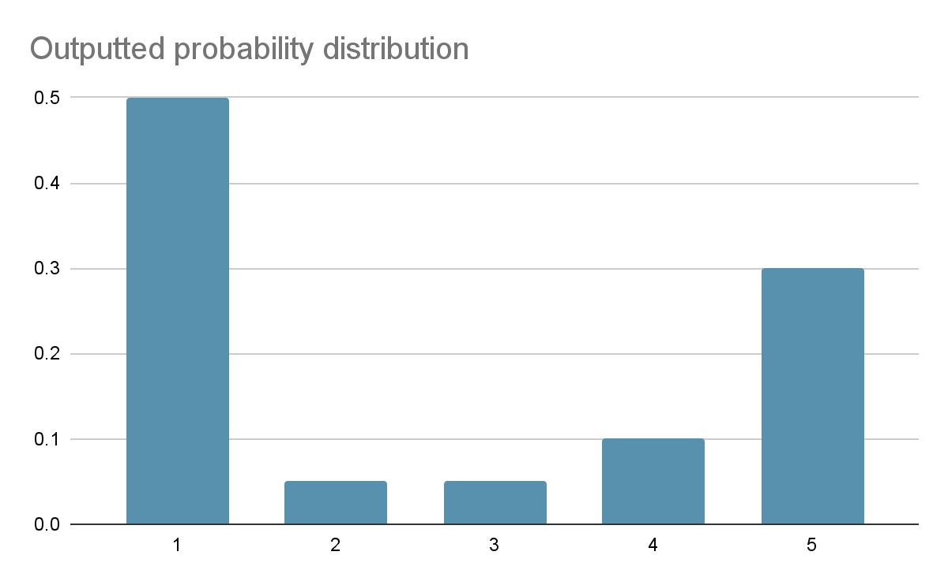
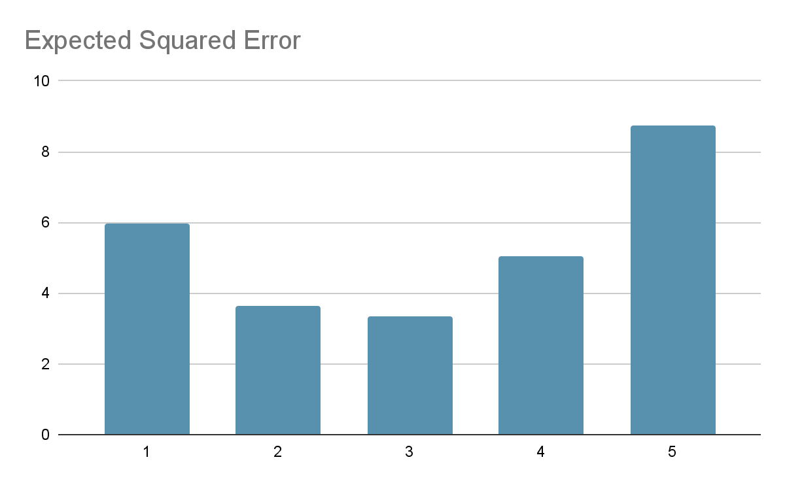
Converting Probability Distribution To Final Prediction
1 star has highest probability mass, but 3 stars minimizes the expected squared error against the label t if t is drawn from the outputted probability distribution.

Slide 27
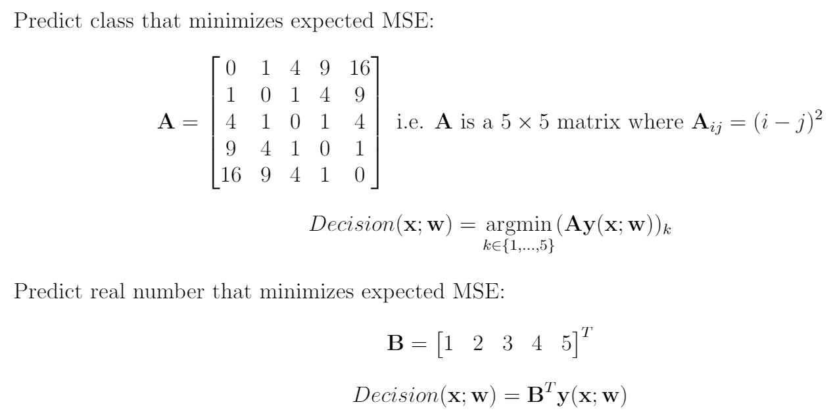
Final Prediction Calculation

Slide 28
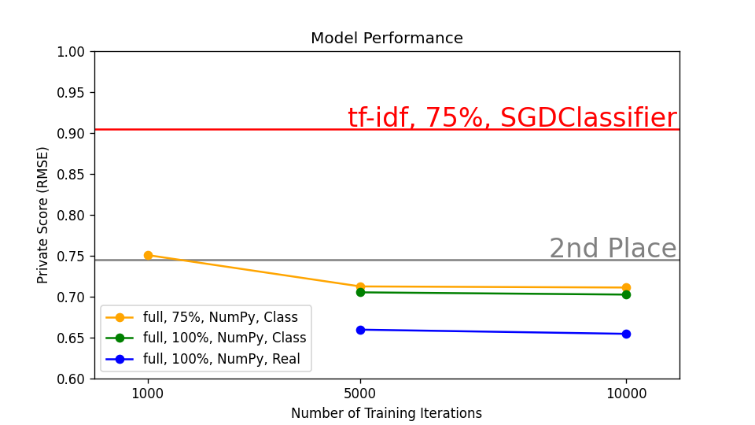
Scores

Slide 29
Thanks :3

